Slide 1
Data Fanatics Team
eCommerce platform Hackathon Case study
Team:
Manish Bhoge
Abhishek Singh
Siddharth B
Aniket Bhide
Halvadia Hinal
Charita Bajaj
Aditya P Namdeo
Gouranga Basak

Slide 2
agenda
Problem Statement
Understanding Source Data
Data Analytics Approach Map
Exploratory Analysis & Observation
Dataset Preparation For Machine Learning
Model(s) Implementation
Model Score Comparison
Analytics Output & Conclusion

Slide 3
Problem Statement
You are a data scientist at Megakkart the largest eCommerce platform in the country. Owing to the festive season Megakkart is planning a ‘Super Festive Sale’ where it wants to achieve GMV sales of INR 500 crores. You are being provided with the user data for the past one year on various parameters mentioned below. You need to identify whether the user on the web portal will make a purchase or not. The company plans to work on various hooks for customers who are at risk of not making a purchase. Your analysis and machine learning model will help the product team to plan these hooks.

Slide 4
Data understanding
The Dataset comprises the e-Commerce information collected across the user sessions over the few months of duration. The dataset represents how various sessions have accessed the eCommerce website and whether the interactions with the products are converted into actual revenue or not. Below are some initial observations on the Dataset:
The given train dataset has a number of 40000 observations and 19 features
The given test dataset has a number of 10000 observations and 18 features
Session_ID is the unique key of this dataset
Continuous Variable = ['administrative', 'administrative_duration', 'informational', 'informational_duration', 'productrelated', 'productrelated_duration', 'bouncerates', 'exitrates', 'pagevalues’, 'specialday', 'region', 'weekend’]
Categorical Variable = ['month', 'operatingsystems', 'browser', 'traffictype', 'visitortype’]
There are NO missing values in the given train Dataset features
Dataset has a 15.8% conversion rate i.e. in the given 40000 observations 6331 observations are converted into the actual revenue

Slide 5
Data Analytics Approach Map
Source Data
ML Model
Train
Data Set
Logistic Regression Model
Data Cleansing
Exploratory Analysis
Outlier Treatment
Encoding
Splitting the Data – Train & Test
Test
Data Set
Decision Tree Model

Slide 6
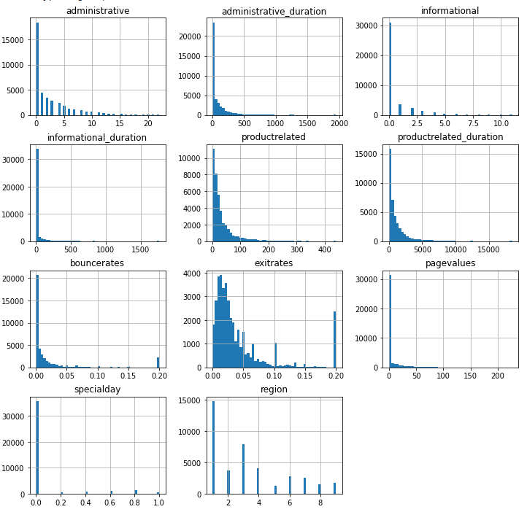
DATA Exploratory Analysis & Observation
Data Distribution :
The histogram on the right side represents the general pattern in the numerical data. By looking at the skewness of the histogram we can easily infer that the model can learn easily from the dataset. Moreover, the specific insights are:
Pageview count and duration are left skewed
Outliers are extreme right end and clearly distinguishable
Bounce, exit rates are skewed towards zero (left)
Exit rates are normally distributed
Data can be categorized into different regions. However, it is represented in the numerical format
Special day has 6 categories and it is an ordinal variable hence it can’t be encoded i.e. not convertible in any form

Slide 7
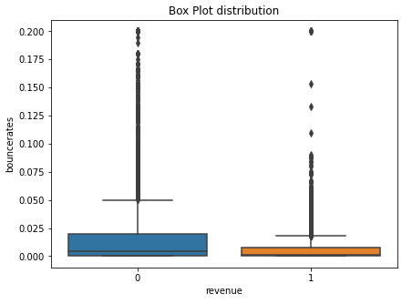
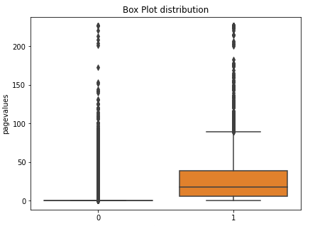
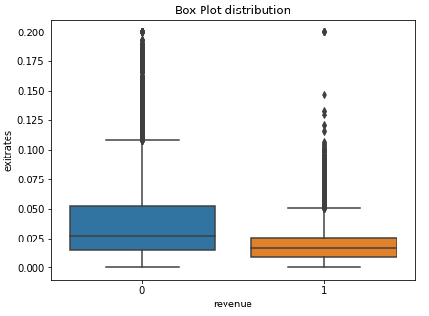
DATA Exploratory Analysis & Observation
Some Interesting Data Insights :
More the bounce rate more the chances that the user won’t buy, hence it lowers the revenue
Page value is a very important variable to decide the revenue
Higher the exit rate the chance the user won't buy.
Notes:
More time spent on the information gives more revenue
more the exit more the chances the user value won't buy
Page value is very important variable to decide the revenue
Region is not affacting the revenue

Slide 8
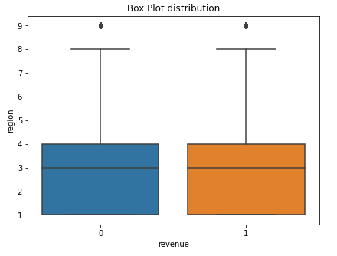
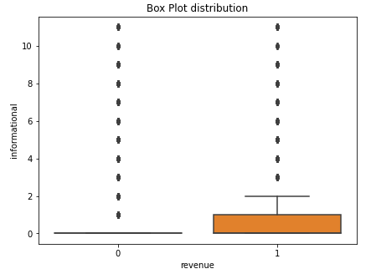
DATA Exploratory Analysis & Observation
Some Interesting Data Insights :
Regions are not affecting the overall revenue
More time spent on the information gives more revenue
Notes:
More time spent on the information gives more revenue
more the exit more the chances the user value won't buy
Page value is very important variable to decide the revenue
Region is not affacting the revenue

Slide 9
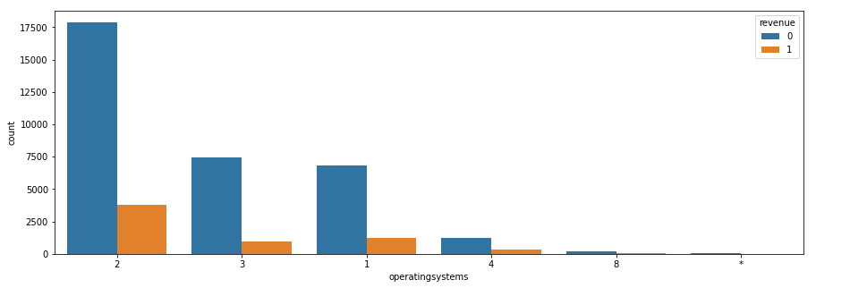
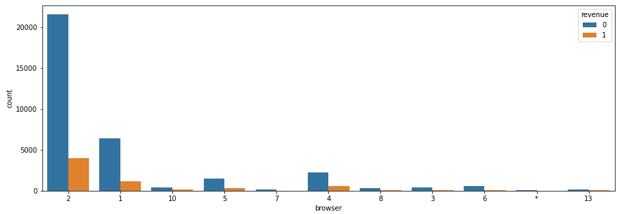
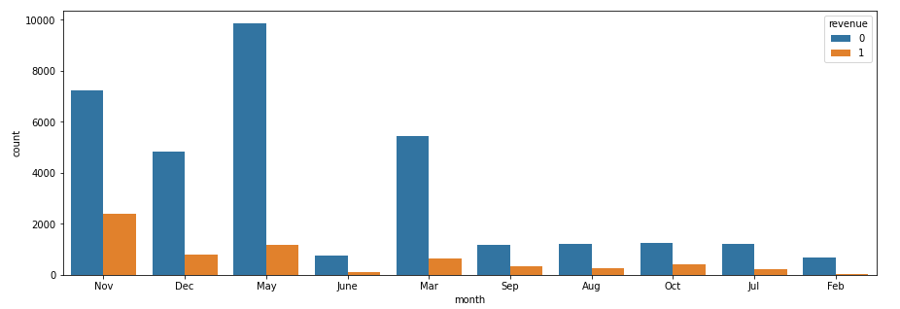
DATA Exploratory Analysis & Observation
Observations on Individual Features :
Maximum number of users is from OS 2 (~54%) and has a very good conversion rate (~17%)
Browser 1 and 2 together 82.7% of users and15.5% conversion rate
Browser 10 has 2.3% of users and 23% conversion rate
Sales Revenue is good in November and May

Slide 10
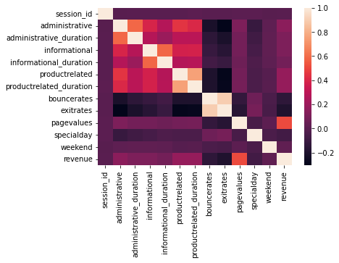
DATA Exploratory Analysis & Observation
Correlation & Multicollinearity Observations :
We observed that the administrative variable is ~58% correlated with administrative duration
Informational variable is ~58.1% with informational duration
Product-related variable is ~75% correlated with product-related duration variable
Bounce rate variable is ~89.4% correlated with exit rates variable
Bounce rate and exit rate are closely correlated
Time duration is correlated with the corresponding page
Summary: We can either create the derived variable out of highly correlated variables or drop one of the correlated variables

Slide 11
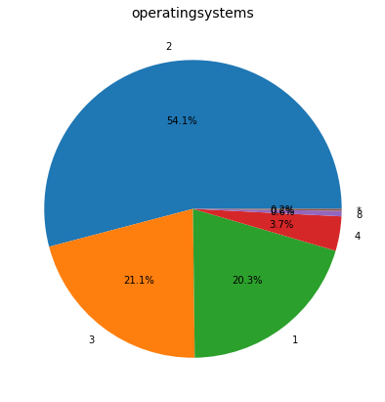
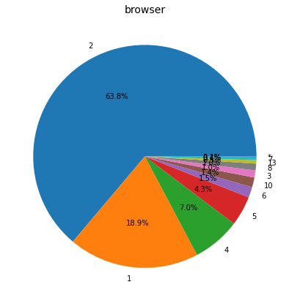
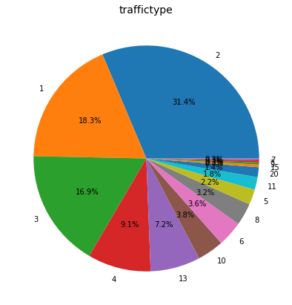
DATA Exploratory Analysis & Observation
Let’s Observe the biases:
Data for Operatingsytems, Browser, and Traffictype are biased towards few observations so we can categorize the remaining parts as “Others”

Slide 12
Data preparation for Machine Learning
Machine Learning Model Data Preparation Recipe :
Based on the various exploratory analysis (univariate, bivariate), correlation, and after removing multicollinearity from the Data we have restructured the dataset into the extended dataset to feed into the machine learning model. Below are the attributes:
session_id, bouncerates, exitrates, pagevalues, specialday, weekend, revenue, Avg_adm_time_spent, Avg_inf_time_spent, Avg_prod_time_spent, month_Dec, month_Feb, month_Jul, month_June,
month_Mar, month_May, month_Nov, month_Oct, month_Sep, OS_1, OS_2, OS_3, browser_1, browser_4, browser_5, region_2, region_3, region_4, region_5, region_6, region_7, region_8,
region_9, traffictype_1, traffictype_10, traffictype_13, traffictype_3, traffictype_4, traffictype_5, traffictype_6, traffictype_8, visitortype_New_Visitor, visitortype_Returning_Visitor
Now these attributes will be used in the classification model to predict the revenue

Slide 13
Model Implementation
Below are the classification models that we are using to predict the revenue classes:
Logistic Regression Model
Decision Tree Classifier

Slide 14
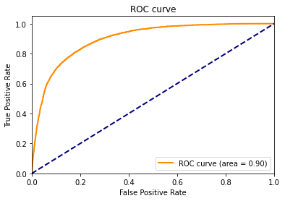
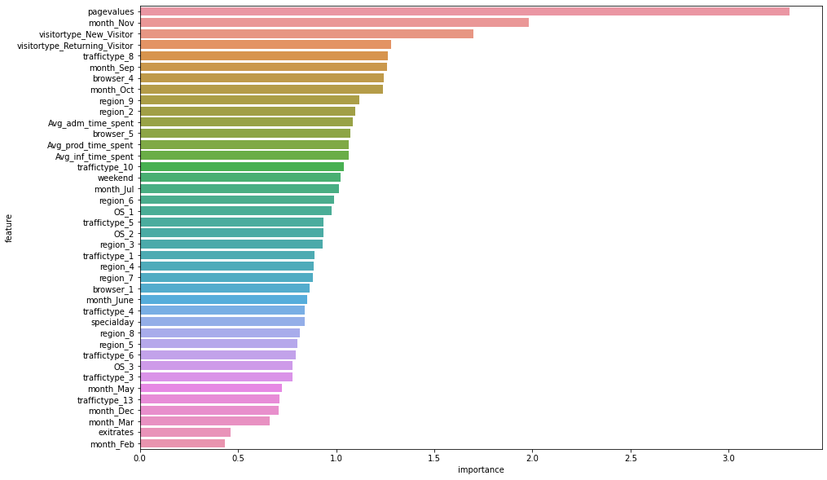
Model Score
Let’s observe the ROC curve and Feature Importance :
ROC Curve for Train sample

Slide 15
Analytics output and conclusion
Below are the classification models that we are using to predict the revenue classes:
Logistic Regression Model
Decision Tree Classifier

Slide 16
Thanks

